Slide 1

SATELLITES, DISTANCE APPROXIMATION, FEASIBILITY TEST, COLLISION DETECTION, SATELLITE HARDWARE, ALGORITHMS IMPLEMENTATION
Capstone Project Phase A
24-2-D-29
Supervisor: Mr. Ilya Zeldner
Shir Cohen 316216340
Yotam Aharon 208608448

Slide 2
Overview
Introduction 3-4
Background 5-6
Algorithms for Collision Detection 7-10
Expected Results 11
Solution 12-20
Expected Challenges 21
Verification and Validation 22
User Interface 23-24

Slide 3
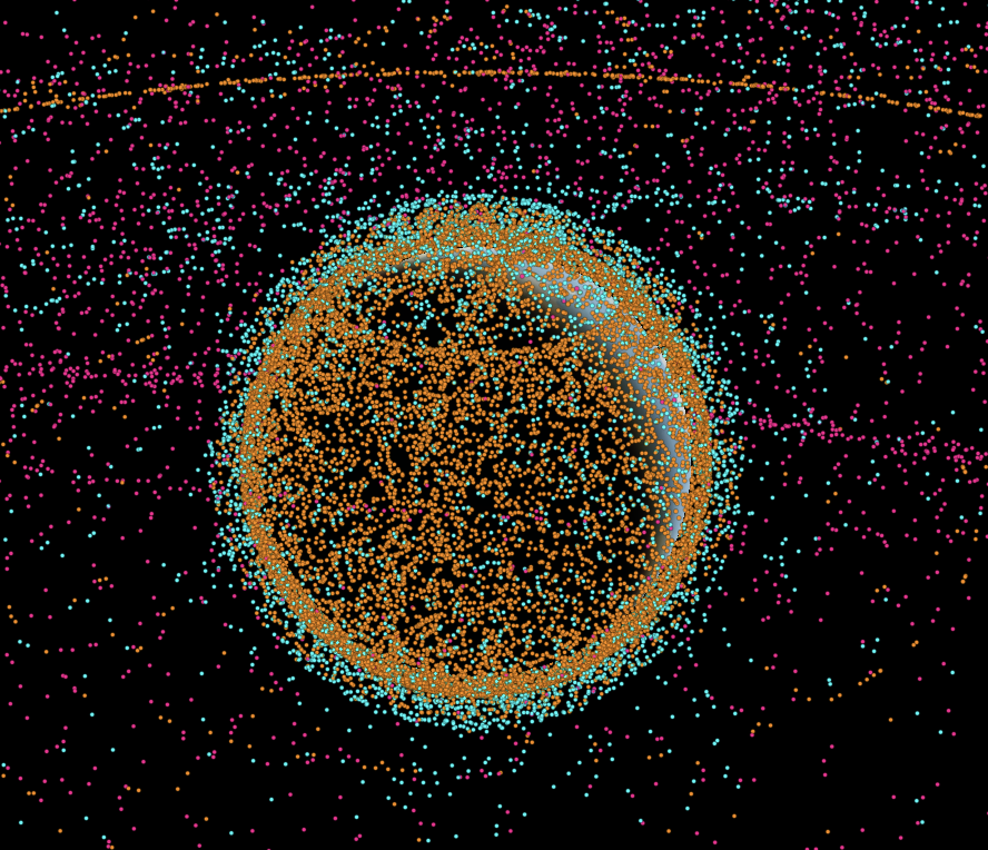
Introduction
Active\Old Satellites, Space debris 19/09/24
Satellites
Space debris
Finding possible collisions
Autonomous satellite.
Active satellite
Inactive satellite
Rocket body
Space debris Uncategorized
http://astria.tacc.utexas.edu/AstriaGraph/
1
2
3
4
5
6
7
8
Introduction
Background
Algorithms
Expected results
Solution
Expected Challenges
Verification
plan
User interface
3

Slide 4
Introduction
Build on prior work titled "Feasibility Analysis and Performance Testing of Collision Detection Algorithms for Satellites”.
Transition from theoretical to practical implementation, focusing on testing algorithms on satellite On-Board Computers (OBC)​.
1
2
3
4
5
6
7
8
Introduction
Background
Algorithms
Expected results
Solution
Expected Challenges
Verification
plan
User interface
4

Slide 5
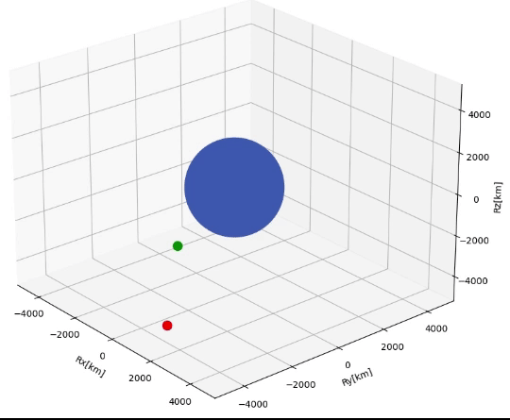
Background
Finding the future orbit
Propagators
SGP4 Standard General Perturbations Satellite Orbit Model 4
LEMUR2[green] – COSMOS[blue]
1
2
3
4
5
6
7
8
Introduction
Background
Algorithms
Expected results
Solution
Expected Challenges
Verification
plan
User interface
5

Slide 6
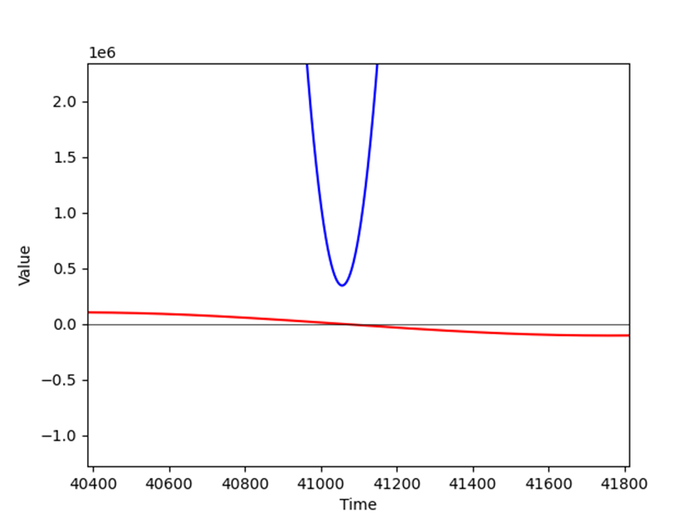
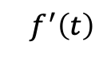
Background
Graph 1, relative distance and derivative over time
$$f^{′}\left(t\right)=2{r′}_{relative}∙r_{relative}= 2v_{relative}∙r_{relative}$$
${ f}^{′}\left(t\right)$
– blue, - red
1
2
3
4
5
6
7
8
Introduction
Background
Algorithms
Expected results
Solution
Expected Challenges
Verification
plan
User interface
6

Slide 7
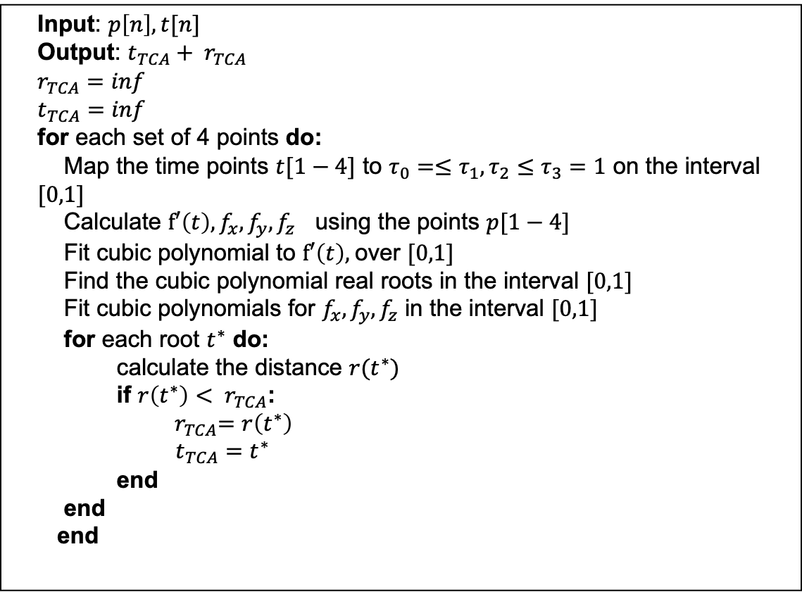
Algorithms
Input: $p\left[n\right],t[n]$
Output: $t_{TCA}+ r_{TCA}$
$$r_{TCA}=inf$$
$$t_{TCA}=inf$$
for each set of 4 points do:
Map the time points $t[1−4]$ to $τ_{0}=≤τ_{1},τ_{2}≤τ_{3}=1$ on the interval $[0,1]$
Calculate $f′\left(t\right),f_{x},f_{y},f_{z}$ using the points $p[1−4]$
Fit cubic polynomial to $f′\left(t\right),$over $[0,1]$
Find the cubic polynomial real roots in the interval $[0,1]$
Fit cubic polynomials for $f_{x},f_{y},f_{z}$ in the interval $[0,1]$
for each root $t^{∗}$ do:
calculate the distance $r(t^{∗})$
if ${r\left(t^{∗}\right)< r}_{TCA}$:
${ r}_{TCA}=r\left(t^{∗}\right)$
$t_{TCA}=t^{∗}$
end
end
end
ANCAS - Alfano Negron Close Approach Software
Cubic polynomial using 4 points
Roots: solving a 3rd degree equation
1
2
3
4
5
6
7
8
Introduction
Background
Algorithms
Expected results
Solution
Expected Challenges
Verification
plan
User interface
7

Slide 8
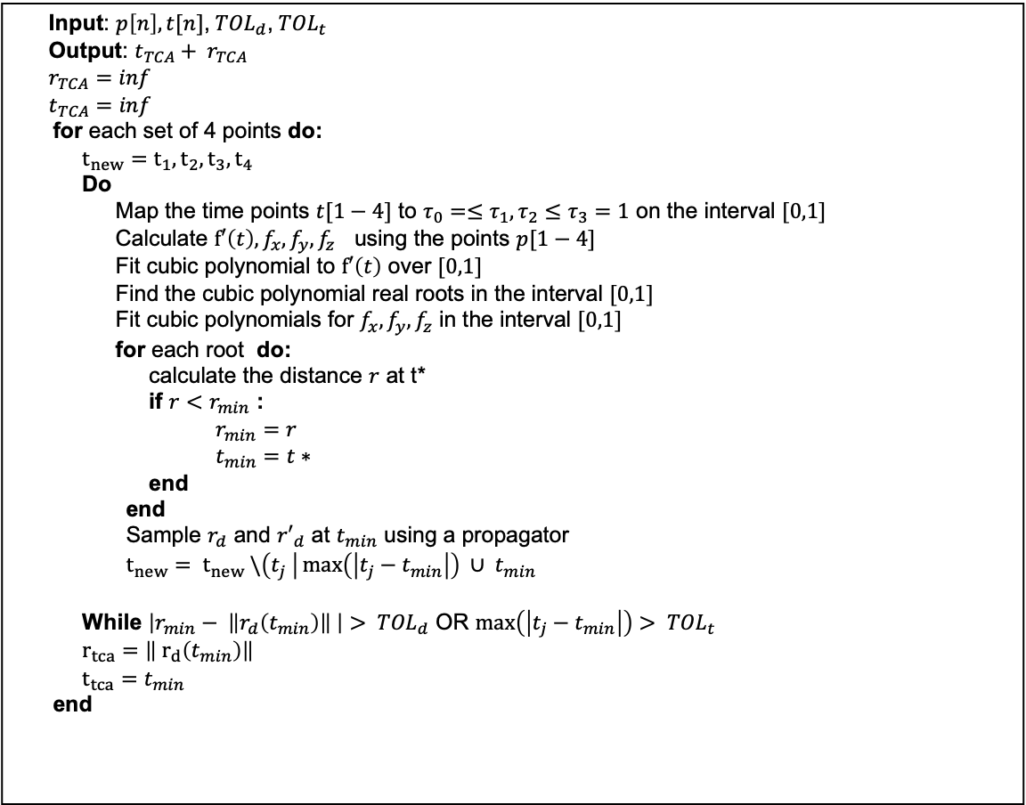
Algorithms
Input: $p\left[n\right],t[n]$, ${TOL}_{d}$, ${TOL}_{t}$
Output: $t_{TCA}+ r_{TCA}$
$$r_{TCA}=inf$$
$$t_{TCA}=inf$$
for each set of 4 points do:
$$t_{new}=t_{1},t_{2},t_{3},t_{4}$$
Do
Map the time points $t[1−4]$ to $τ_{0}=≤τ_{1},τ_{2}≤τ_{3}=1$ on the interval $[0,1]$
Calculate $f′\left(t\right),f_{x},f_{y},f_{z}$ using the points $p[1−4]$
Fit cubic polynomial to $f′\left(t\right)$ over $[0,1]$
Find the cubic polynomial real roots in the interval $[0,1]$
Fit cubic polynomials for $f_{x},f_{y},f_{z}$ in the interval $[0,1]$
for each root do:
calculate the distance $r$ at t*
if $r<r_{min}$ :
$r_{min}=r$
$t_{min}=t∗$
end
end
Sample $r_{d}$ and ${r′}_{d}$ at $t_{min}$ using a propagator
$t_{new}= t_{new} \backslash \left(t_{j} \right|\max\left(\left|t_{j}−t_{min}\right|\right) ∪ t_{min}$
While $\left|r_{min}− \left\|r_{d}\left(t_{min}\right)\right\| \right|> {TOL}_{d}$ OR $\max\left(\left|t_{j}−t_{min}\right|\right)> {TOL}_{t}$
$r_{tca}=\left\| r_{d}\left(t_{min}\right)\right\|$
$t_{tca}=t_{min}$
end
SBO-ANCAS - Alfano Negron Close Approach Software
Cubic polynomial using 4 points
But uses additional points to get better results
Tolerance in time and tolerance in distance
Roots: solving a 3rd degree equation
1
2
3
4
5
6
7
8
Introduction
Background
Algorithms
Expected results
Solution
Expected Challenges
Verification
plan
User interface
8

Slide 9
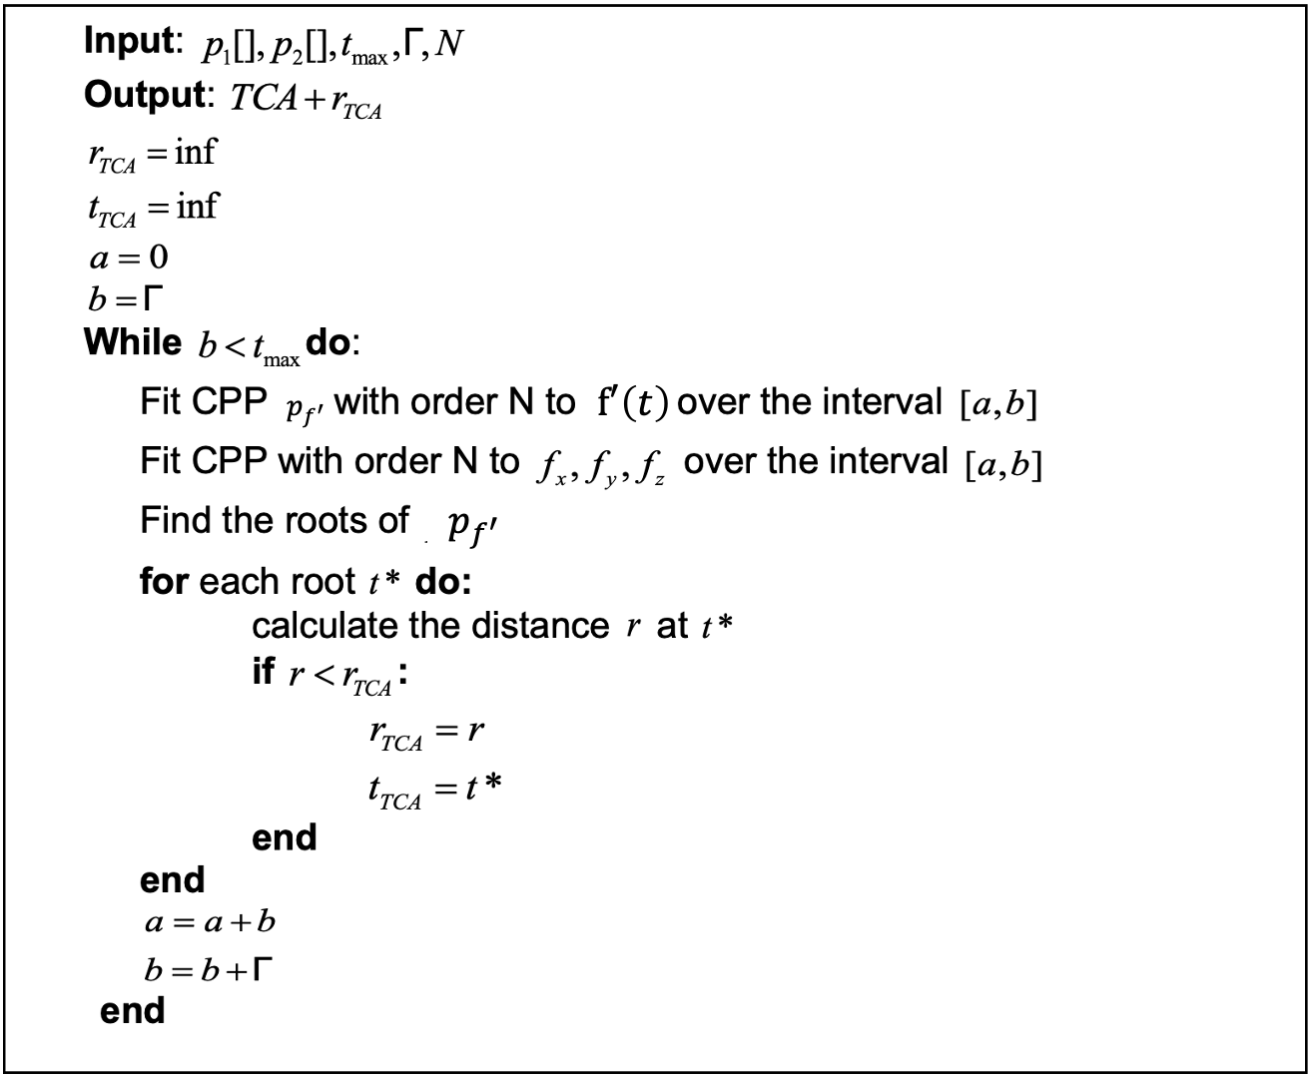
Algorithms
CATCH - Conjunction Assessment Through Chebyshev Polynomials
Using Chebyshev Proxy Polynomials
N degree polynomial using N+1 points
Roots: finding NxN matrix eigen values
1
2
3
4
5
6
7
8
Introduction
Background
Algorithms
Expected results
Solution
Expected Challenges
Verification
plan
User interface
9

Slide 10

Expected result
A comprehensive set of experimental results, derived from testing a variety of input types, that will either confirm or refute the feasibility of executing TCA calculations on the satellite's OBC.
Optimized and reliable implementations of the CATCH algorithm, ready for integration into the satellite system when necessary.
1
2
3
4
5
6
7
8
Background
Algorithms
Expected results
Solution
Expected Challenges
Verification
plan
User interface
10
Introduction
10
Notes:
In this project we expect to finish with concrete and comprehensive proof of feasibility or infeasibility of the task of running the TCA calculations on the satellite OBC.
Feasibility test of : Implementing the algorithms
Running on the Tested OBC
Analyzing the result

Slide 11
Solution
2 Parts testing system- Tested OBC system and Test Station system.
Comparative Analysis of Satellite Boards for Algorithm Testing.
Optimization of Eigenvalue Calculation in the CATCH Algorithm.
Implementing and running the algorithms on the satellite On Board Computer.
1
2
3
4
5
6
7
8
Introduction
Background
Algorithms
Expected results
Solution
Expected Challenges
Verification
plan
User interface
11

Slide 12
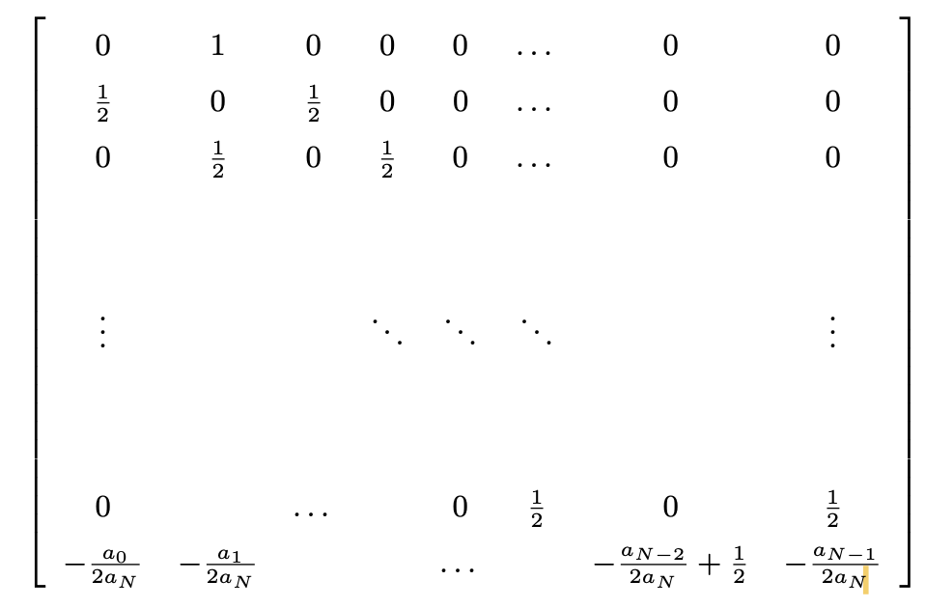
Optimization of Eigenvalue Calculation
The memory on the satellite board is limited, so we don't want to use libraries for calculations.
We prefer to implement this ourselves based on our limitations.
Aim to decrease the number of operations and reducing runtime.
The Companion Matrix [[2],Eq.20]
Sparse Matrix
Near Tridiagonal
Fixed Number of Values in finite range [-1,1]
1
2
3
4
5
6
7
8
Introduction
Background
Algorithms
Expected results
Solution
Expected Challenges
Verification
plan
User interface
12
Notes:
Companion Matrix A:
Sparse Structure: Primarily zeros, reducing storage and computational demands.
Tridiagonal Form: Non-zero elements located on the first sub diagonal and super diagonal.
Fixed Number of Values: The matrix composition is defined by a set number of specific values in range [-1,1] , facilitating predictable computational behavior.
Computational Considerations:
Reducing Operations: Aim to decrease the number of operations, enhancing faster convergence and reducing runtime, particularly for onboard systems
Ongoing Investigation:
Experimental Approaches: Testing various methods to reduce operation count while preserving accuracy.
Potential Impact: Enhancements could significantly improve real-time assessments in satellite operations.

Slide 13
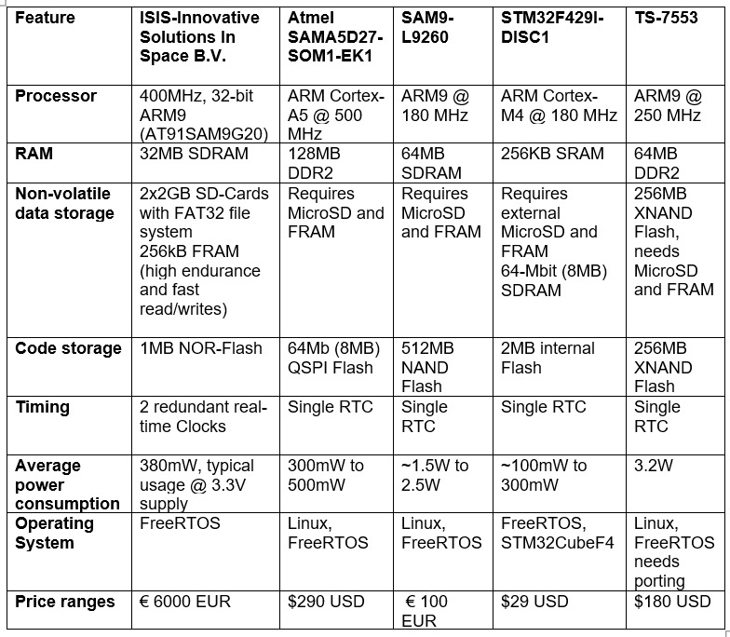
Comparative Analysis of Satellite Boards
Our goal was to identify an alternative board that closely matched the specifications of the ISIS OBC.
By choosing a weaker satellite on-board computer we can achieve the following goals:
Reduce Costs: select less powerful computers, avoiding excess capabilities.
Test Performance: Ensure algorithms function well even in resource-limited settings.
Prove Feasibility: If it works with less, it will work with more.
1
2
3
4
5
6
7
8
Introduction
Background
Algorithms
Expected results
Solution
Expected Challenges
Verification
plan
User interface
13
Notes:
Reduce Costs: select less powerful computers, avoiding excess capabilities.
Test Performance: Ensure algorithms function well even in resource-limited settings.
Prove Feasibility: If it works with less, it will work with more.

Slide 14
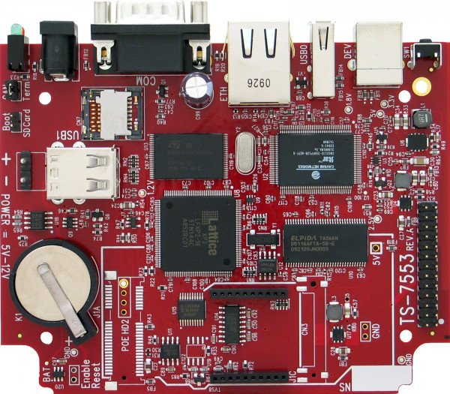
The Selected TS-7553 OBC
The TS-7553 OBC identified as the closest match to the ISIS OBC (processor architecture, memory, and storage).
Offers slightly lower performance, which aligns with our goal of testing in a constrained environment.
Ensures that any optimizations we make will be applicable to the more advanced ISIS OBC, providing relevant and transferable results.
TS-7553 Onboard Computer Front view
Processor: 250MHz ARM9
RAM: 64MB DDR2
Power: 3.2W
Cost: $180 USD.
Modifications: Requires additional MicroSD and FRAM
1
2
3
4
5
6
7
8
Introduction
Background
Algorithms
Expected results
Solution
Expected Challenges
Verification
plan
User interface
14

Slide 15

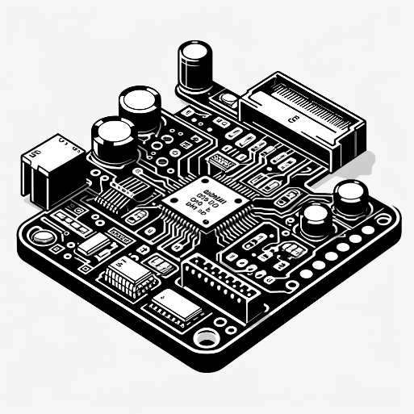
Two Parts Testing System
Test station
Tested on-board computer
User Interface
Test Creation and Management
Results Management
Database
Running tests
Running the algorithms
Testing runtime
1
2
3
4
5
6
7
8
Introduction
Background
Algorithms
Expected results
Solution
Expected Challenges
Verification
plan
User interface
15
15

Slide 16

Wired Communication Strategy for Testing TS-7553 OBC
We will use Ethernet for our system to ensure stable and efficient wired communication between the TS-7553 OBC and the Test Station.
High Data Transfer Rates: Supports up to 1 Gbps for efficient, large data transfers.
Low Latency: Essential for real-time performance testing and prompt algorithm evaluation.
Reliability: Offers stability for continuous, high-volume data exchanges.
The TS-7553 OBC is equipped with an Ethernet port, which allows us to utilize this method without needing additional adapters
1
2
3
4
5
6
7
8
Introduction
Background
Algorithms
Expected results
Solution
Expected Challenges
Verification
plan
User interface
16
16

Slide 17
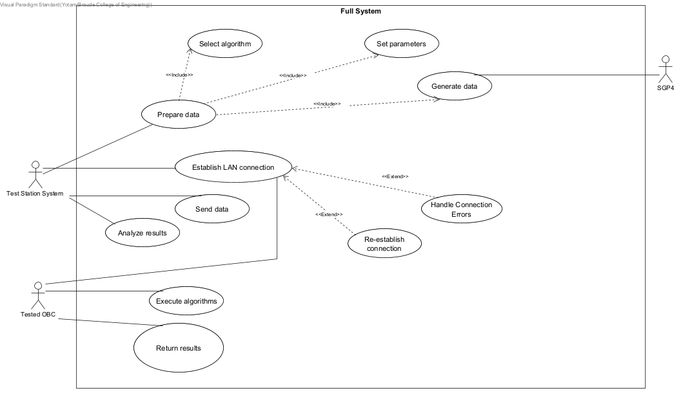
Full System Use Case
1
2
3
4
5
6
7
8
Introduction
Background
Algorithms
Expected results
Solution
Expected Challenges
Verification
plan
User interface
17

Slide 19

Expected Challenges
Limited Processing Power and Memory Constraints.
Real-Time Performance and Latency.
Data Loss and Transmission Errors.
1
2
3
4
5
6
7
8
Introduction
Background
Algorithms
Expected results
Solution
Expected Challenges
Verification
plan
User interface
19

Slide 20
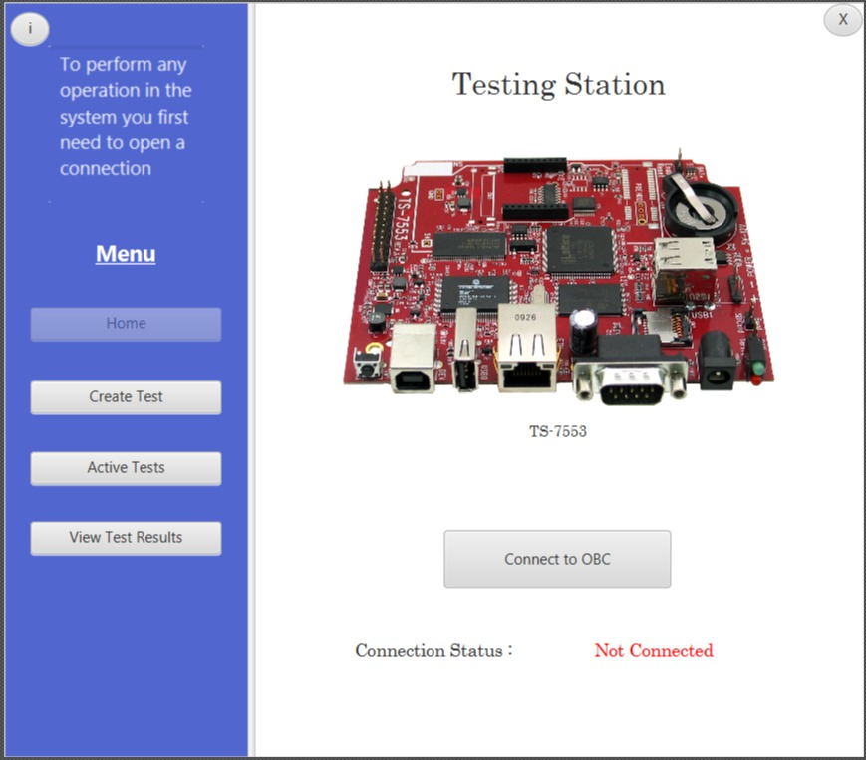
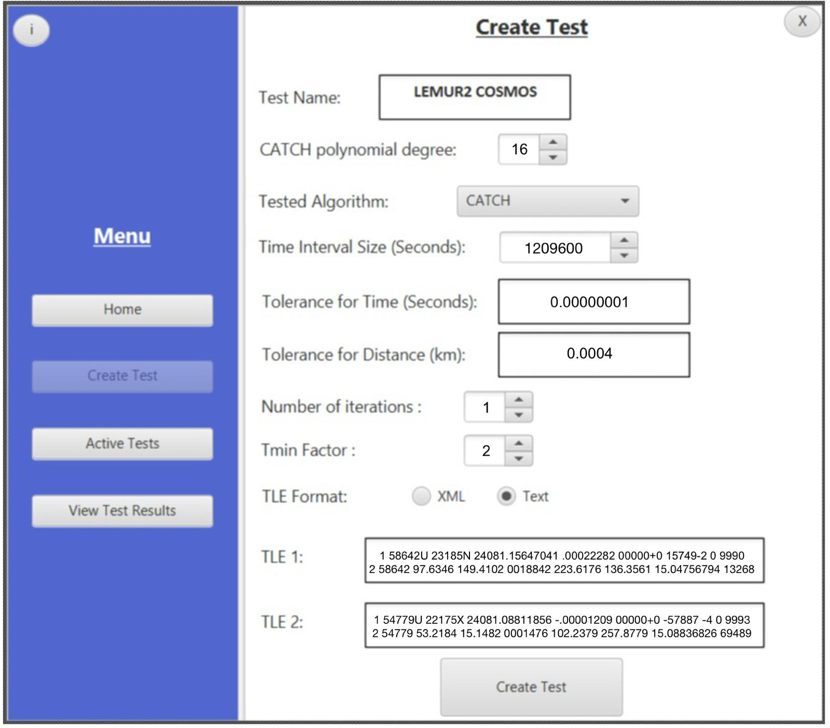
User Interface
Home Page
Create test window

Slide 21
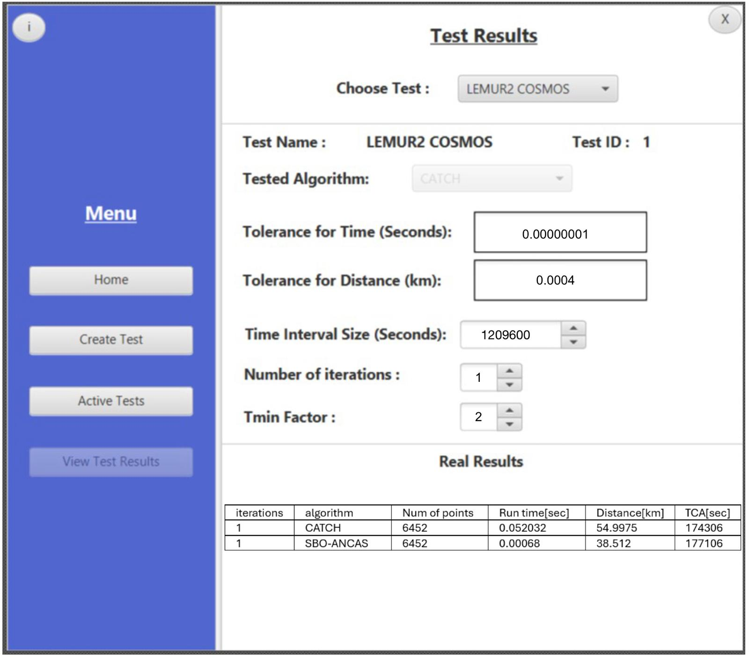
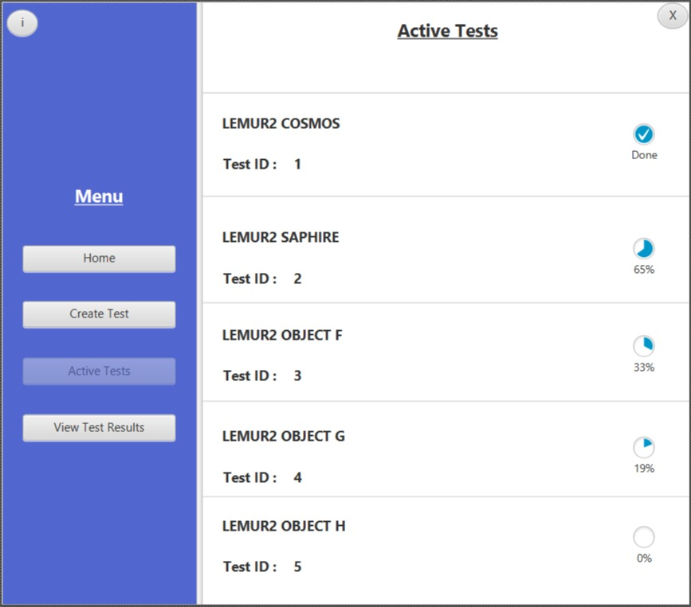
User Interface
Test result window
Active Test view

Slide 22
Verification plan
Testing using Bottom-Up methodology
Test Station
Tested OBC
# | Test description | Expected result
1 | Error in the input data: wrong input data (TLE, either one of the 2 required TLE or both) | No experiment is initiated, error message to the user.
2 | Error in the input data: Missing test variable (Number of iterations, CATCH polynomial degree) | No experiment is initiated, error message to the user.
3 | MSS (main success scenario), correct input values (TLE, variables). | Send correct message and data, save the correct result received from the simulation.
4 | Communication error: receive error message from the Tested OBC (simulated). | Try to send the data again, display error message to the user on repetitive errors.
5 | Communication error: no communication with the Tested OBC. | Display error message to the user.
# | Test description | Expected result
1 | Error in the input data: missing\out of bound test variables. | Send back error message.
2 | Error in the input data: missing data points (missing some of the values for a points in time data composed from r1,v1,r2,v2,t) | Send back error message.
3 | MSS (main success scenario) variations (run ANCAS/CATCH), correct input values (test variables, test data set). | Send back correct result.
4 | Communication error: receive error message from the Testing station. | Try to send the result message again, give up after repetitive errors.
5 | Communication error: no communication from the Testing station | Wait for the station response.
1
2
3
4
5
6
7
8
Introduction
Background
Algorithms
Expected results
Solution
Expected Challenges
Verification
plan
User interface
22

Slide 23
Bibliography
[1] Alfano, S. (1994). Determining Satellite Close Approaches-Part II. ADVANCES IN THE ASTRONAUTICAL SCIENCES, 87, 233 -233. ANCAS
[2] Denenberg, E. (2020). Satellite closest approach calculation through chebyshev proxy polynomials. Acta Astronautica, 170, 55-65. SBO-ANCAS
[3] Denenberg, E., & Gurfil, P. (2016). Improvements to time of closest approach calculation. Journal of Guidance, Control, and Dynamics, 39(9), 1967-1979. CATCH
[4] AstariaGraph satellites and space debris visual map : http://astria.tacc.utexas.edu/AstriaGraph/
[5] CelesTrak: https://celestrak.org/
[6] CelesTrak Current Data: https://celestrak.org/NORAD/elements/index.php?FORMAT=tle
[7] The gem5 simulator: https://www.gem5.org/
[8] ISISPACE OBC: https://www.isispace.nl/product/on-board-computer/
[9] NASA on orbital debris: NASA
[10] Our GitHub repository: https://github.com/cohensh96/Satellite-s-project
1
2
3
4
5
6
7
8
Introduction
Background
Algorithms
Expected results
Solution
Expected Challenges
Verification
plan
User interface

Slide 24
Thank You!
Do you have any questions?

